Slide 1
Backpropagation
Backpropagation, an abbreviation for "backward propagation of errors", is a common method of training artificial neural networks used in conjunction with an optimization method such as gradient descent.
The method calculates the gradient of a loss function with respect to all the weights in the network.
The gradient is fed to the optimization method which in turn uses it to update the weights, in an attempt to minimize the loss function.
Backpropagation requires a known, desired output for each input value in order to calculate the loss function gradient. It is therefore usually considered to be a supervised learning method

Slide 2
Backpropagation
Backpropagation requires that the activation function used by the artificial neurons (or "nodes") be differentiable.

Slide 3
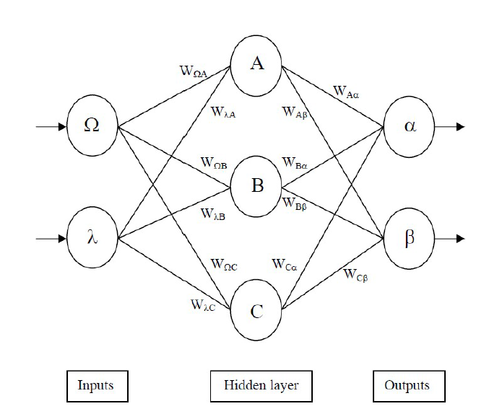

Slide 4
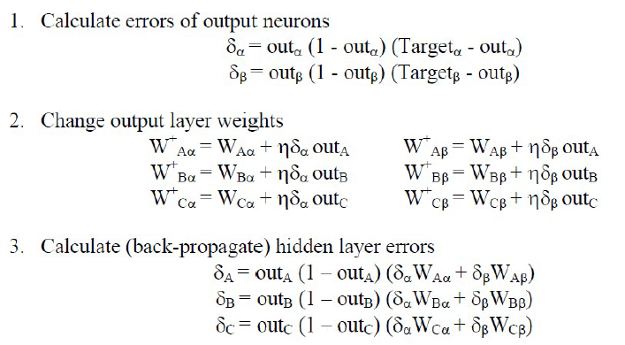

Slide 5
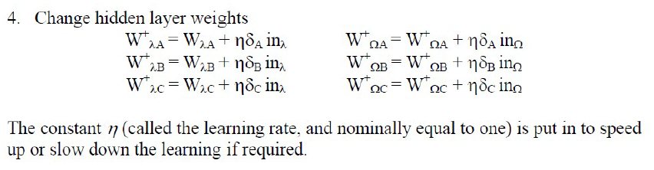

Slide 6
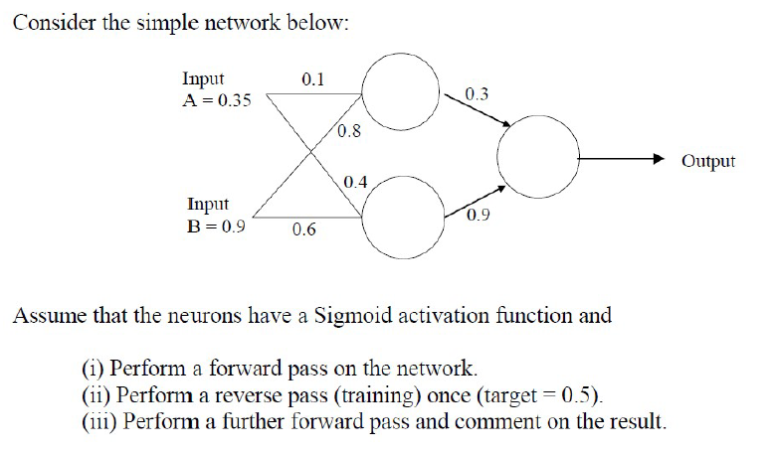

Slide 7
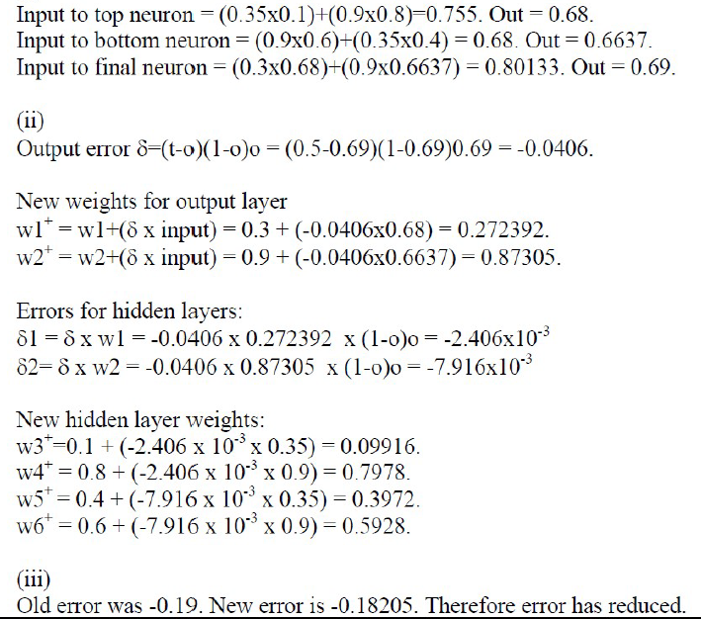

Slide 8
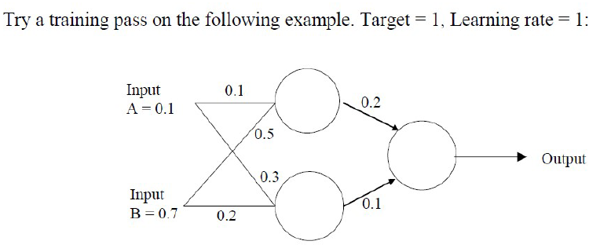

Slide 9
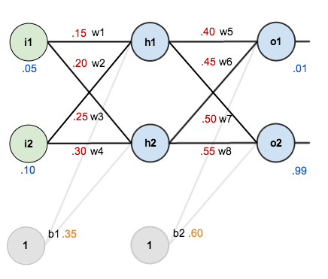
Backpropagation
we’re going to use a neural network with two inputs, two hidden neurons, two output neurons. Additionally, the hidden and output neurons will include a bias.

Slide 10
Backpropagation
The goal of backpropagation is to optimize the weights so that the neural network can learn how to correctly map arbitrary inputs to outputs.
Let the given inputs be 0.05 and 0.10, we want the neural network to output 0.01 and 0.99.
THE FORWARD PASS
We figure out the total net input to each hidden layer neuron, squash the total net input using an activation function (here we use the logistic function), then repeat the process with the output layer neurons.

Slide 11
Backpropagation
Here’s how we calculate the total net input for :
We then squash it using the logistic function to get the output of

Slide 12
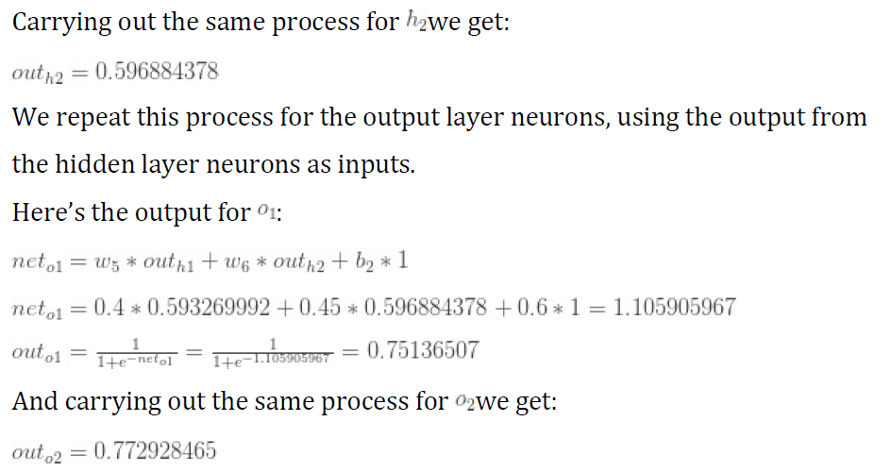
Backpropagation

Slide 13
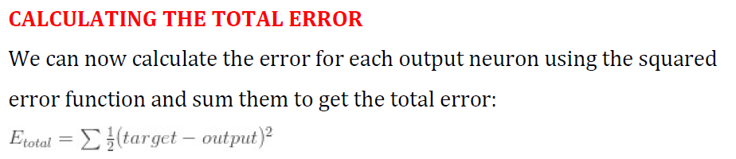
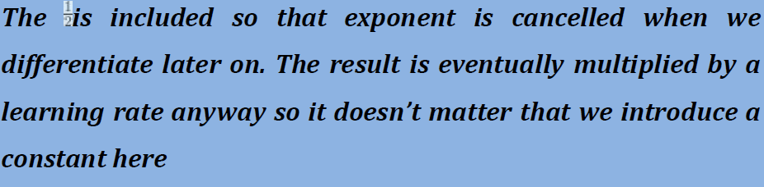
Backpropagation

Slide 14
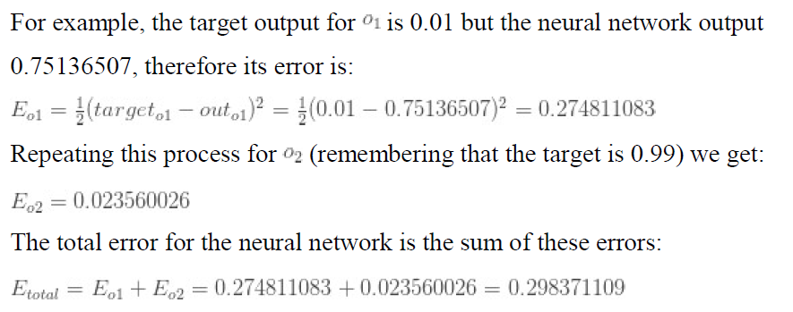
Backpropagation

Slide 15
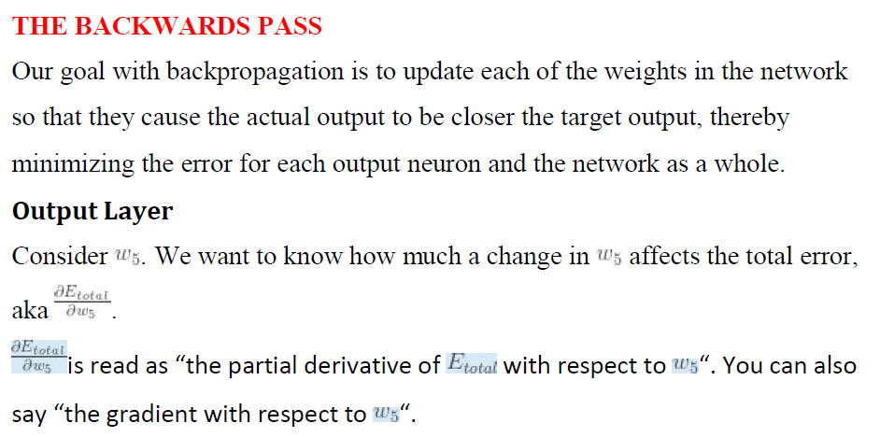

Slide 16
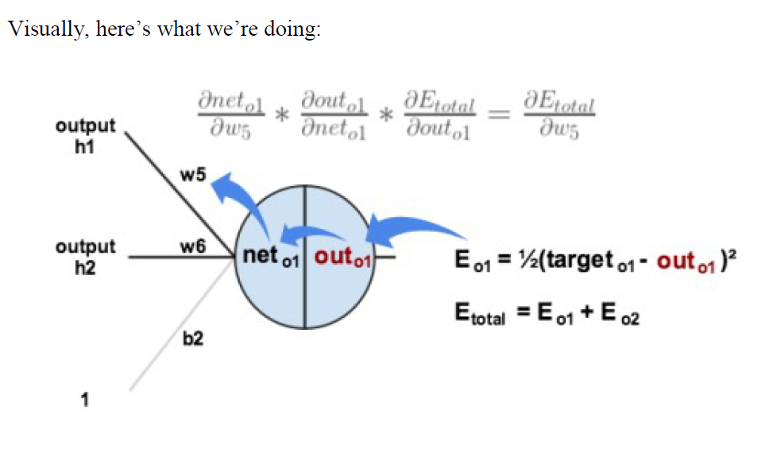

Slide 17
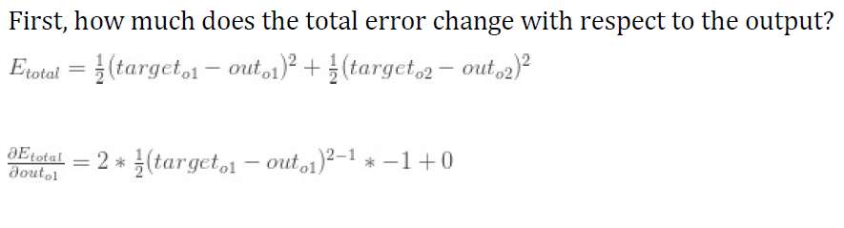

Slide 18
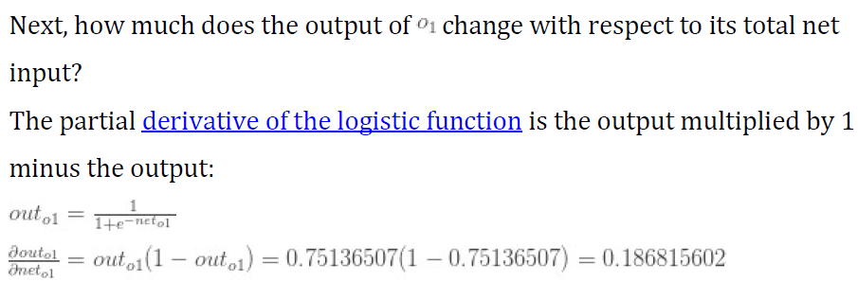
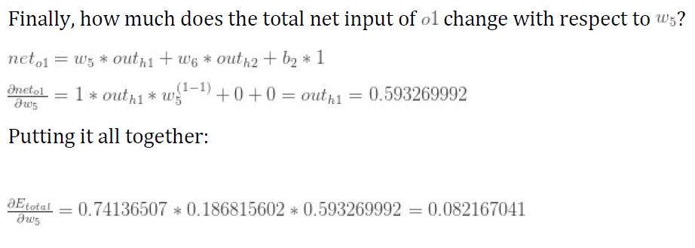

Slide 19
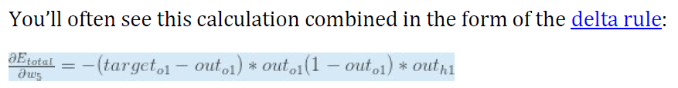
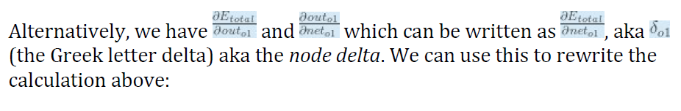

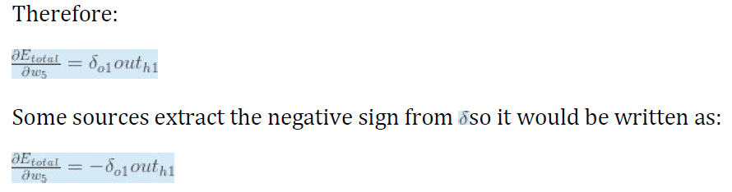

Slide 20
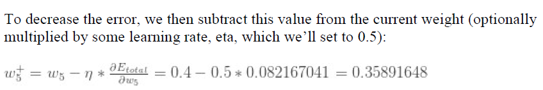
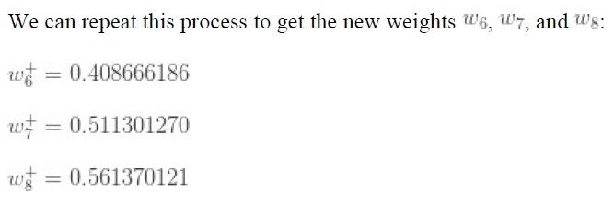

Slide 21

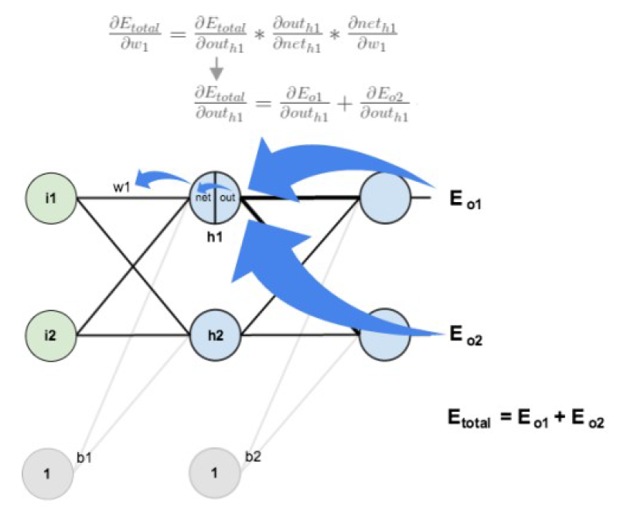

Slide 22
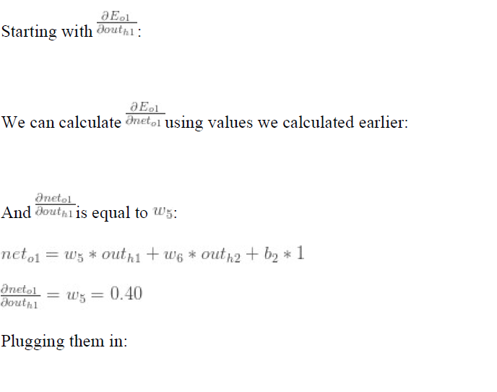

Slide 23
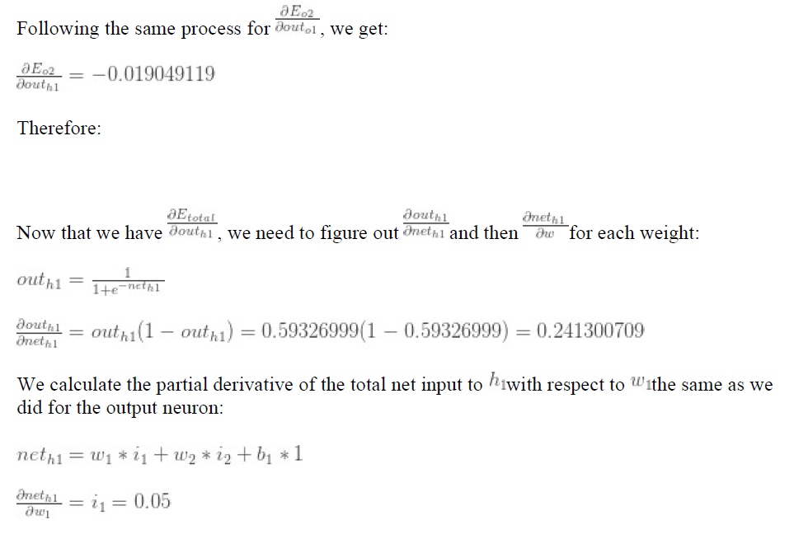

Slide 24
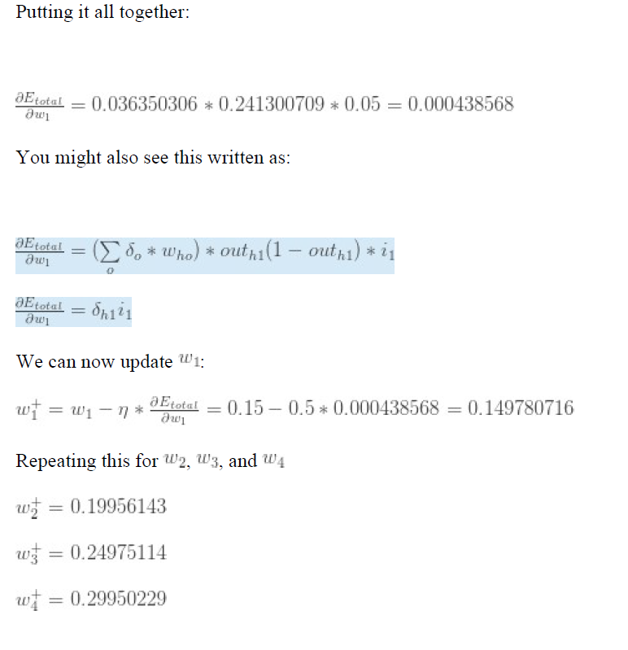

Slide 25
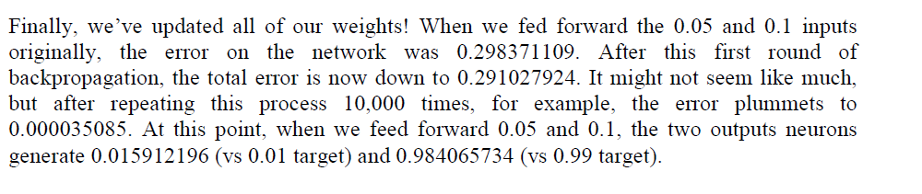

Slide 26
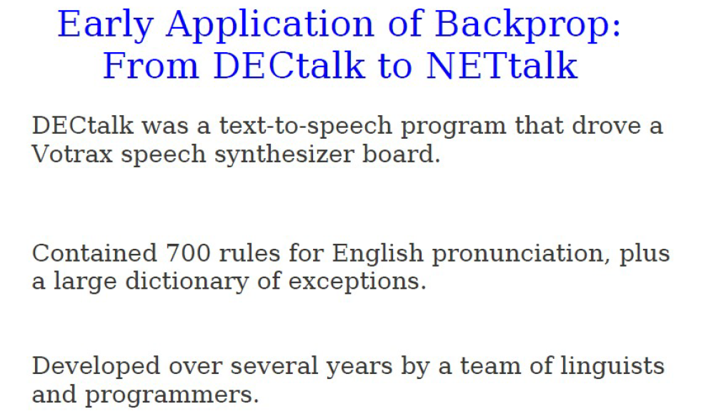

Slide 27
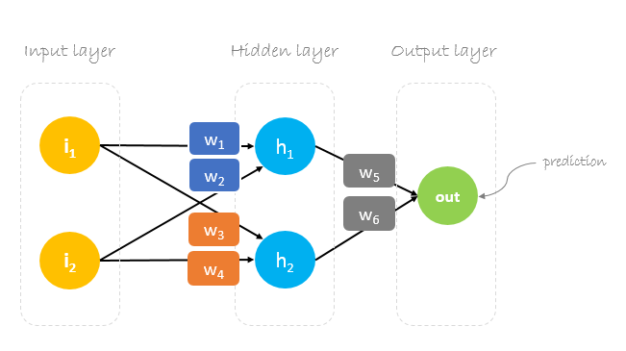
Another example

Slide 28
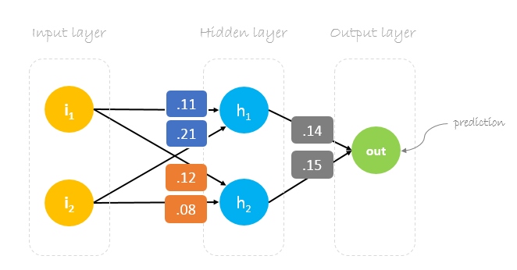
Neural network training is about finding weights that minimize prediction error. We usually start our training with a set of randomly generated weights. Then, backpropagation is used to update the weights in an attempt to correctly map arbitrary inputs to outputs.
Our initial weights will be as following: w1 = 0.11, w2 = 0.21, w3 = 0.12, w4 = 0.08, w5 = 0.14 and w6 = 0.15

Slide 29
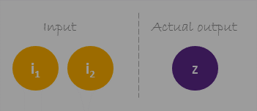
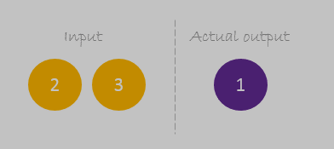
Dataset
Our dataset has one sample with two inputs and one output.
Our single sample is as following inputs=[2,3] and output=[1].
Forward Pass
We will use given weights and inputs to predict the output. Inputs are multiplied by weights; the results are then passed forward to next layer.

Slide 30
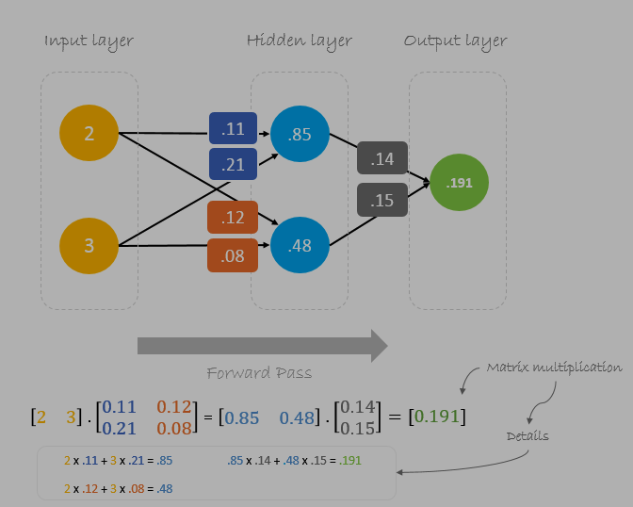

Slide 31
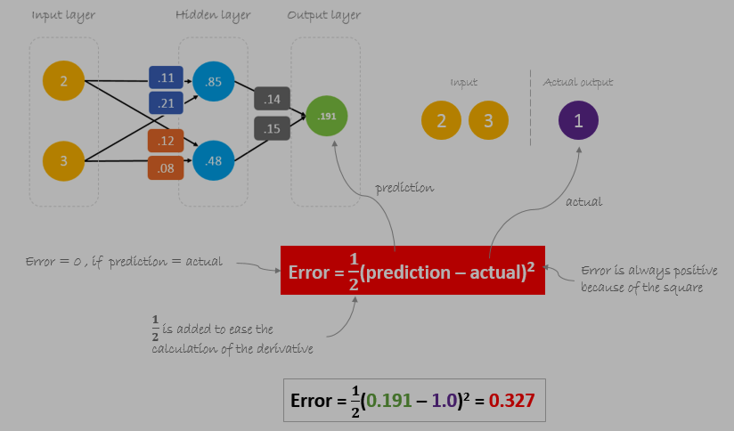
Calculating Error
Now, it’s time to find out how our network performed by calculating the difference between the actual output and predicted one. It’s clear that our network output, or prediction, is not even close to actual output.
We can calculate the difference or the error as following.

Slide 32
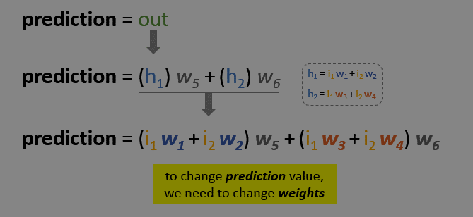
Reducing Error
Our main goal of the training is to reduce the error or the difference between prediction and actual output. Since actual output is constant, “not changing”, the only way to reduce the error is to change prediction value.
The question now is, how to change prediction value?
By decomposing prediction into its basic elements we can find that weights are the variable elements affecting prediction value. In other words, in order to change prediction value, we need to change weights values.

Slide 33
The question now is how to change\update the weights value so that the error is reduced?
The answer is Backpropagation!
Backpropagation
Backpropagation, short for “backward propagation of errors”, is a mechanism used to update the weights using gradient descent. It calculates the gradient of the error function with respect to the neural network’s weights. The calculation proceeds backwards through the network.
Gradient descent is an iterative optimization algorithm for finding the minimum of a function; in our case we want to minimize th error function. To find a local minimum of a function using gradient descent, one takes steps proportional to the negative of the gradient of the function at the current point.

Slide 34
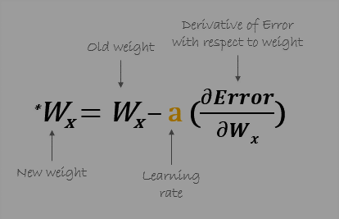

For example, to update w6, we take the current w6 and subtract the partial derivative of error function with respect to w6. Optionally, we multiply the derivative of the error function by a selected number to make sure that the new updated weight is minimizing the error function; this number is called learning rate.

Slide 35
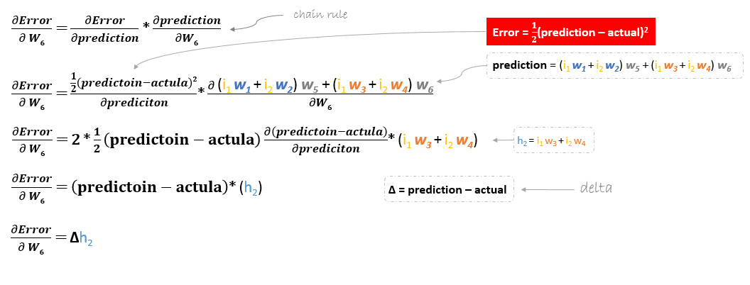
The derivation of the error function is evaluated by applying the chain rule as following

Slide 36

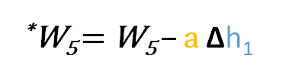
So to update w6 we can apply the following formula
Similarly, we can derive the update formula for w5 and any other weights existing between the output and the hidden layer.
However, when moving backward to update w1, w2, w3 and w4 existing between input and hidden layer, the partial derivative for the error function with respect to w1, for example, will be as following.

Slide 37
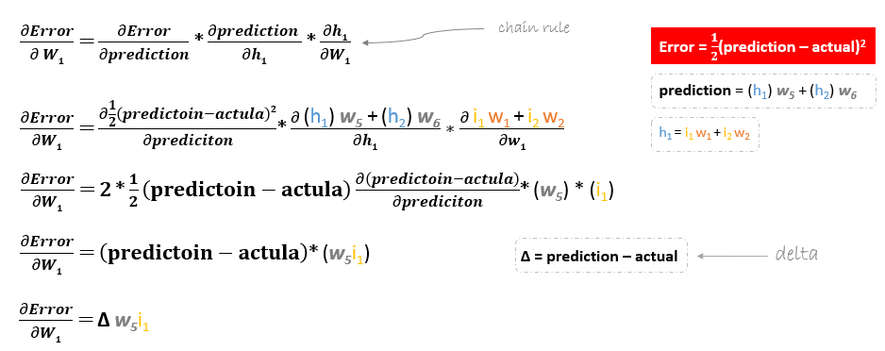
We can find the update formula for the remaining weights w2, w3 and w4 in the same way.

Slide 38
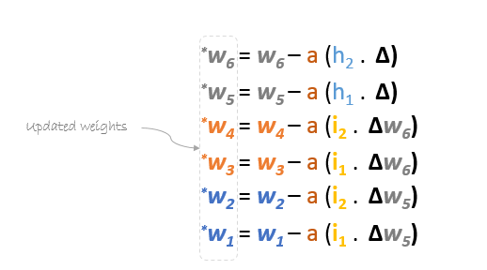
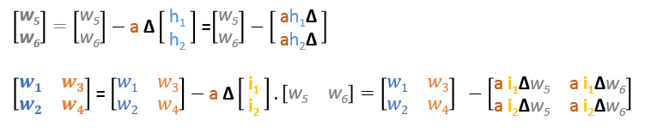
In summary, the update formulas for all weights will be as following:
We can rewrite the update formulas in matrices as following

Slide 39
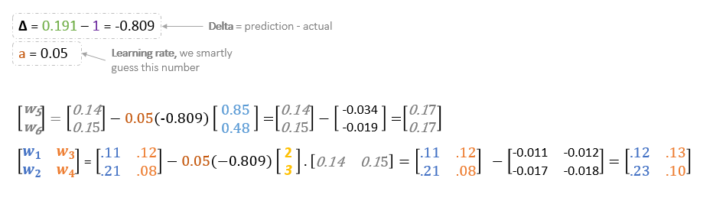
Backward Pass
Using derived formulas we can find the new weights.
Learning rate: is a hyperparameter which means that we need to manually guess its value.
Now, using the new weights we will repeat the forward passed

Slide 40
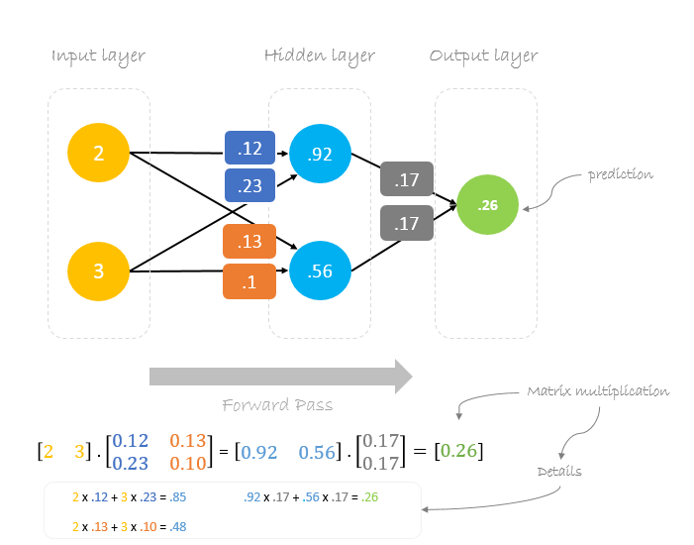
We can notice that the prediction 0.26 is a little bit closer to actual output than the previously predicted one 0.191. We can repeat the same process of backward and forward pass until error is close or equal to zero.

